Slide 1
DDOS ATTACKS ANALYSIS based on RF-SVM
Final Project Presentation
Yasaswi Kolasani
CSI 536 Machine Learning

Slide 2
ABSTRACT
Effective Detection of DDOS Attacks.
Detection based on feature selection.
Exploiting Random Forest for computing feature importance.
SVM used to rescreen the features.
Finally, an optimal feature subset is obtained, which will reach a higher detection rate and recall rate.
Resource: https://ieeexplore.ieee.org/document/8089926

Slide 3
Proposed Algorithm RF-SVM
Combination of RANDOM FOREST and SVM.
Random Forest:
-Large collection of de-correlated decision trees.
-Construct multiple decision trees randomly and gains the final
classification result by voting.
-Used to compute importance values of the features.
3. SVM:
Used to Rescreen the features obtained from random forest by considering each neglected feature in each iteration.

Slide 4
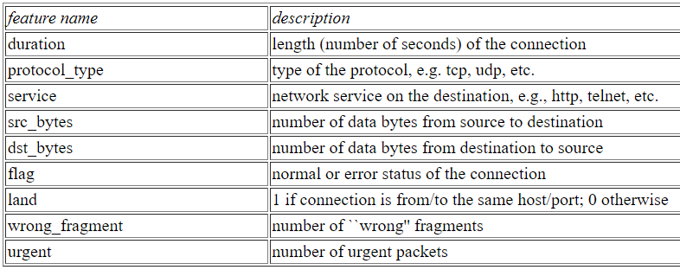
KDD99 DATASET
Resource: http://kdd.ics.uci.edu/databases/kddcup99/kddcup99.html

Slide 5
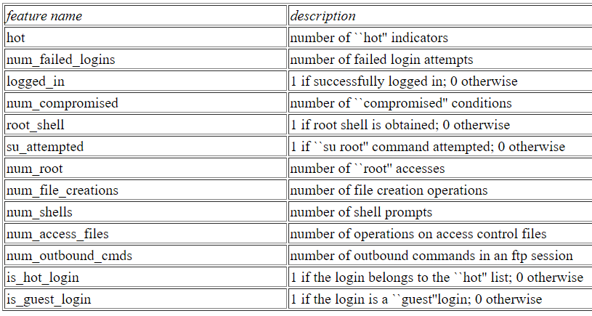
KDD99 DATASET
Resource: http://kdd.ics.uci.edu/databases/kddcup99/kddcup99.html

Slide 6
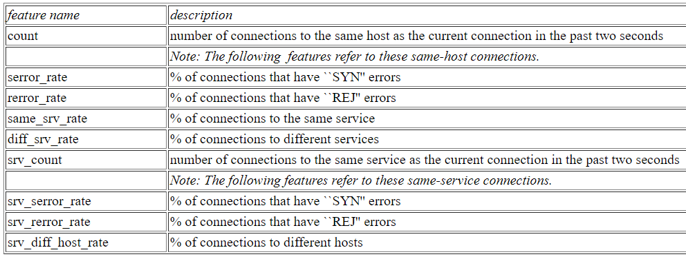
KDD99 DATASET
Resource: http://kdd.ics.uci.edu/databases/kddcup99/kddcup99.html

Slide 7
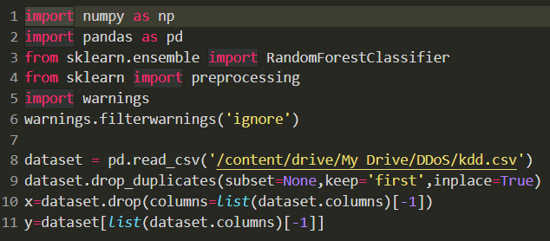
Implementation
Import Modules and load the data

Slide 8
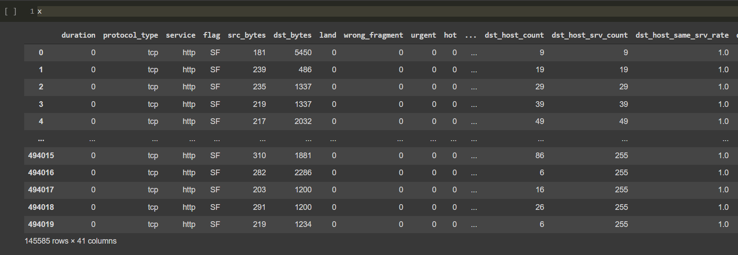
Contd..
Image of dataset of shape (145585,41) -> 41 features

Slide 9
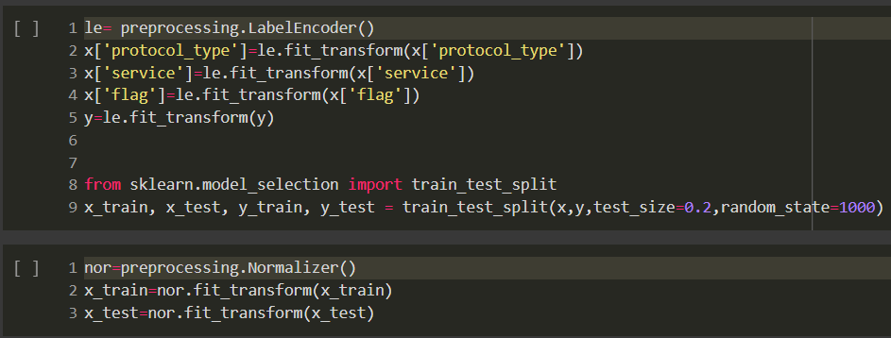
Contd..
Data Preprocessing
Label encoding and normalizing the data

Slide 10
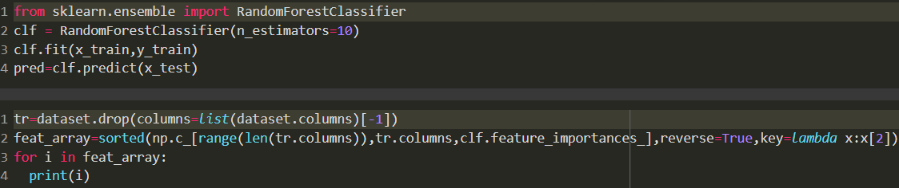
Contd..
Implementation of random forest to get the feature importance values

Slide 11
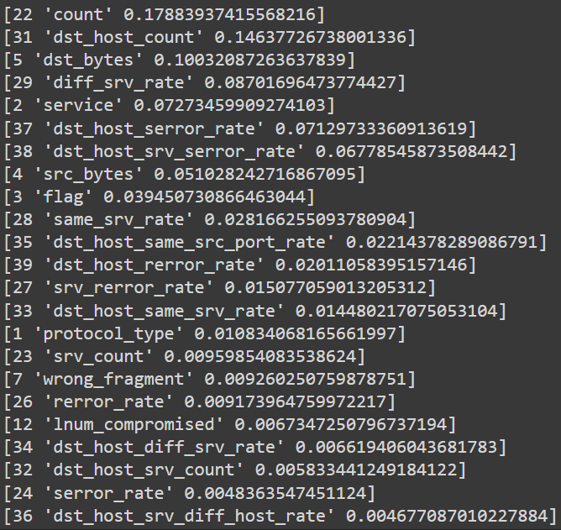
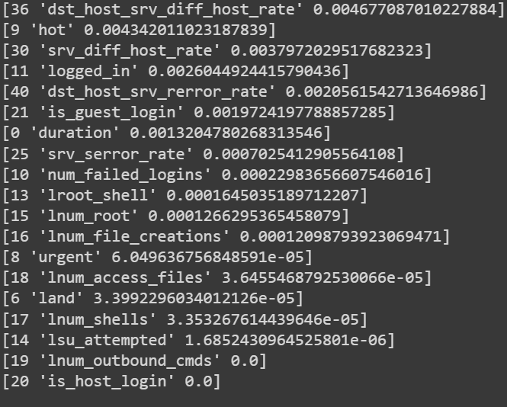
Contd..
Features with importance values in descending order

Slide 12
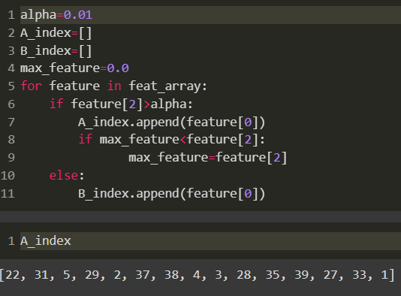
Contd..
Retrieve the feature subset

Slide 13
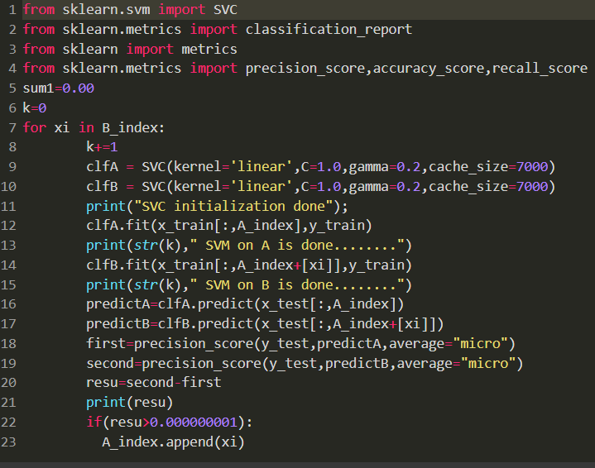
Contd..
Implementing SVM

Slide 14
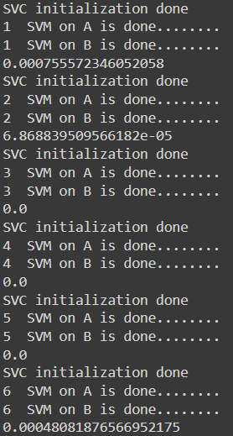
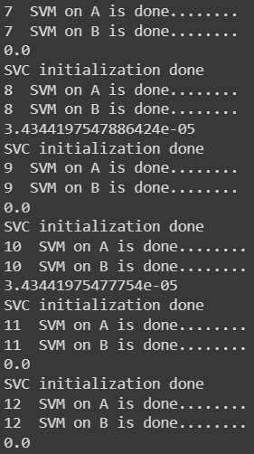
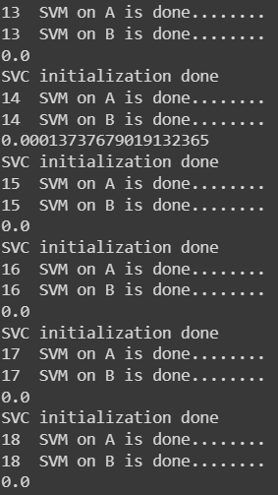
Contd.. SVM Results

Slide 15
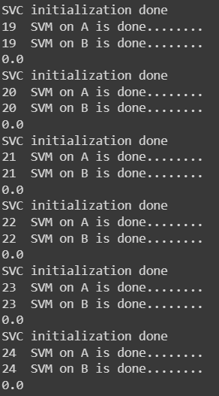
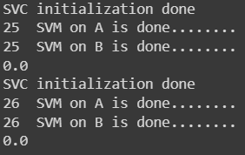
Contd.. SVM Results

Slide 16
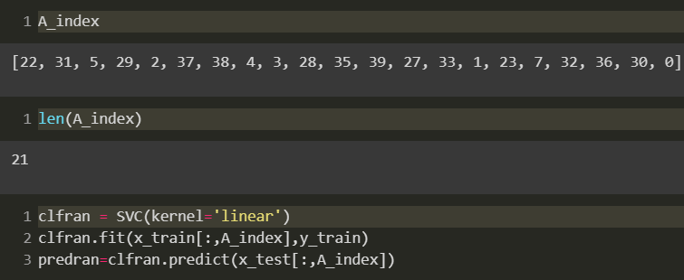
Contd..
SVM on optimal feature subset to compute evaluation metrics

Slide 17
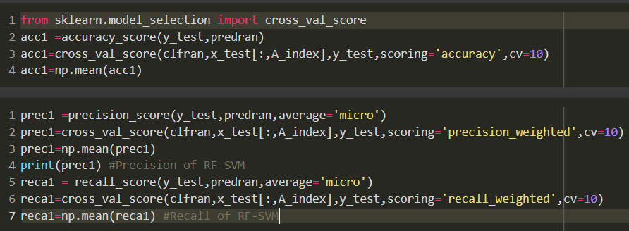
Contd.. Compute the evaluation metrics
Computation of Accuracy, precision, recall
Cross validation to avoid overfitting

Slide 18
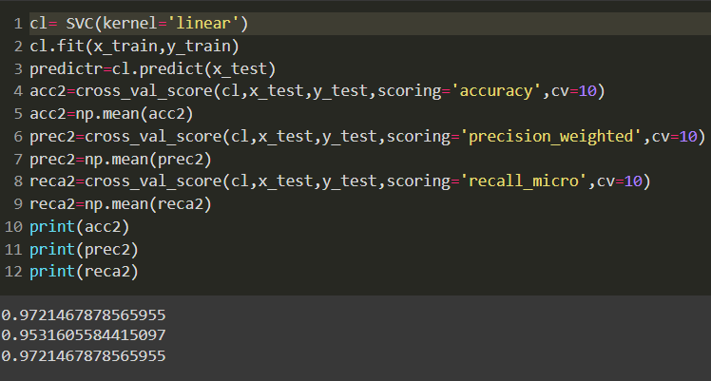
Contd.. Compare with different algorithms
SVM

Slide 19
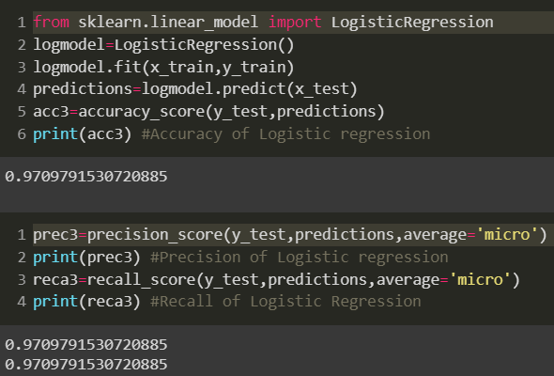
Contd.. Logistic regression

Slide 20
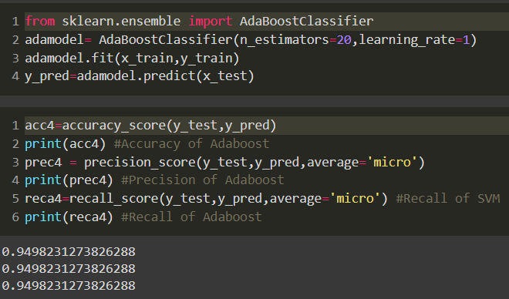
Contd.. Adaboost

Slide 21
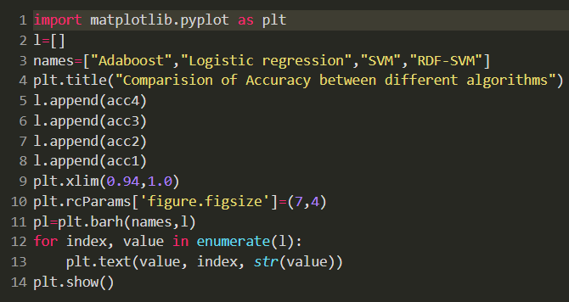
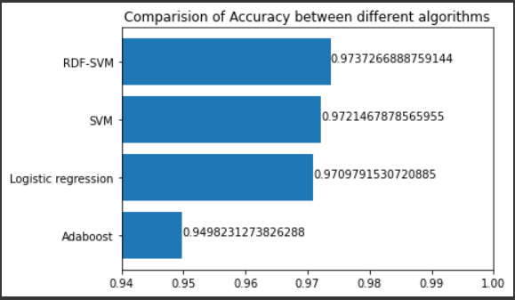
Contd..
Comparison of Accuracy

Slide 22
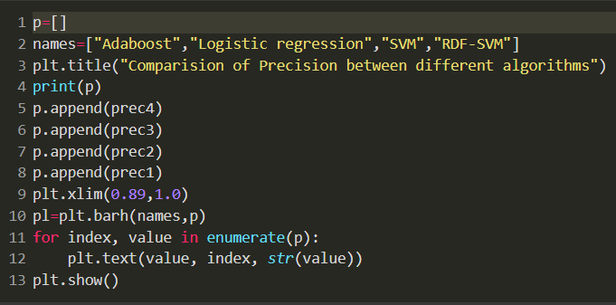
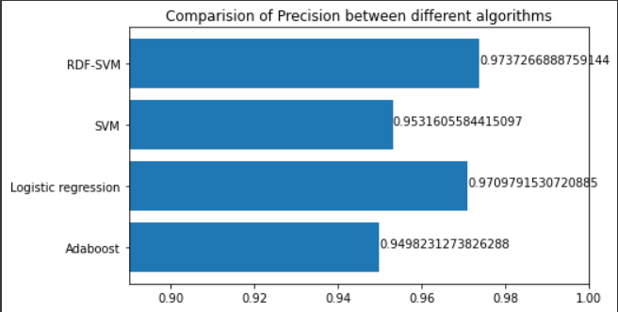
Contd..
Comparison of Precision

Slide 23
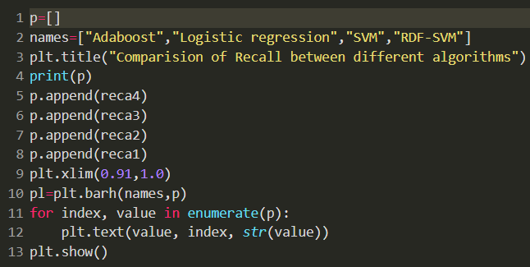
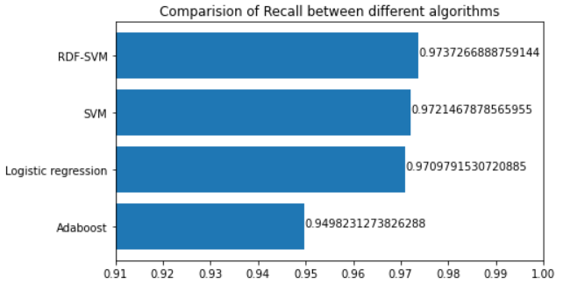
Contd..
Comparison of Recall

Slide 24

Contd..
Indices of features selected for optimal feature subset

Slide 25
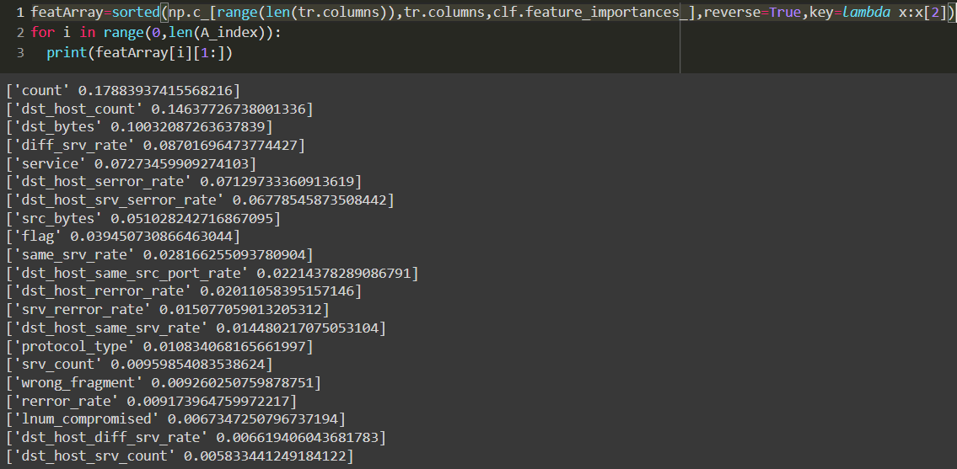
Contd.. Features selected for optimal feature subset

Slide 26
Conclusion
SVM rescreened the unimportant features and added them to feature subset.
Obtained Optimal feature subset.
[‘count’,’ dst_host_count’,’ dst_bytes’,’ diff_srv_rate’, ‘service’, ‘dst_host_serror_rate’, ‘dst_host_srv_serror_rate’, ‘src_bytes’,’ flag’, ‘same_srv_rate’, ‘dst_host_same_src_port_rate’, ‘dst_host_rerror_rate’, ‘srv_rerror_rate’, ‘dst_host_same_srv_rate’, ‘protocol_type’, ‘srv_count’, ‘wrong_fragment’, ‘rerror_rate’, ‘lnum_compromised’, ‘dst_host_diff_srv_rate’, ‘dst_host_srv_count’]
It got accuracy of 97% and precision of 96% and recall of 97%.

Slide 27
Thank You

